Slide 1

ImpactMe.in
Turn your passion into profession
“A Fan-Funding Platform for Artist which creates a meaningful revenue stream, while maintaining their creative freedom”

Slide 2
Problem
1
Independent Artists/Content Creators struggle to get a Stable Revenue Stream
Monetary value of work is less.
Copyright issues.
Monetary interaction with fans is costly.

Slide 3

Solution
2
ImpactME.in website.
“Turn your Passion into Profession”
CREATOR
Stable Revenue Stream
Build a Strong and Reliable Community
Retain Creative Liberty
FANS
Rewards from the Creators
Early/Exclusive Access to some Content
Better Interaction with the Creator

Slide 4
Product
3
CREATOR
FAN
Create page
Sign up
Set tiers and rewards
Choose a tier
Get revenue
Get Rewards

Slide 5
Business Model
How we make money
4
Creator’s Share 90%
Average Transaction Fee 5%
ImpactMe.in’s SHARE 5%
( Optional 1 % for charity)

Slide 6
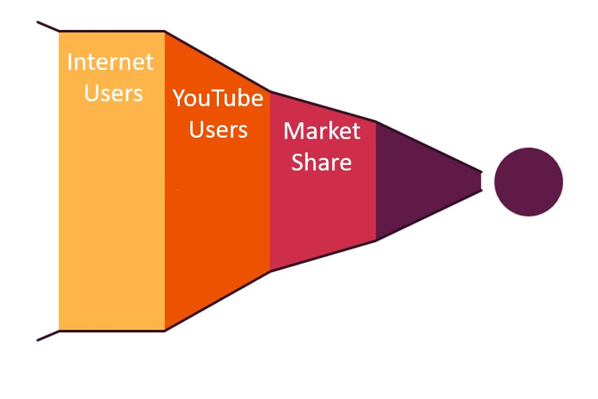
Market
India only
5
5%
200 M
720 M
225 M
80 M
200 M
Revenue Generated
@₹50 per Fan
Source: Announced by Google at it’s event Brandcast 2018

Slide 7


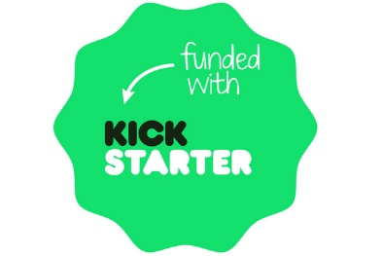
Competition
6
MORE CONVENIENT
ImpactMe.in
MORE EXPENSIVE
LESS EXPENSIVE
All Crowdfunding Platforms
are an Indirect Competition.
LESS CONVENIENT

Slide 8
Growth Strategy
7
MARKETING & SALES
CUSTOMER SERVICE
Approaching youtubers with more than 100,000 subscribers.
Approaching Instagramers with more than 75,000 followers.
Providing creators monetary benefits to promote the website.
Retain full control
You own your content
Rally your biggest fans
Full-time cheerleaders
We do the heavy lifting

Slide 9
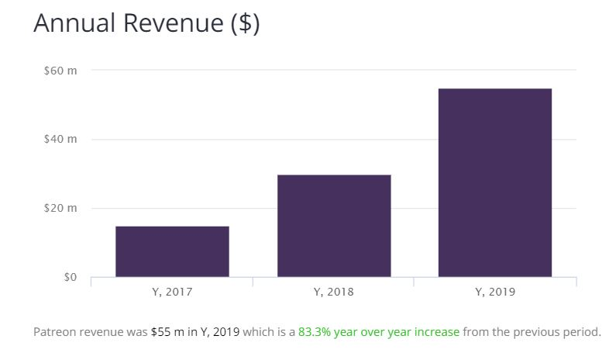
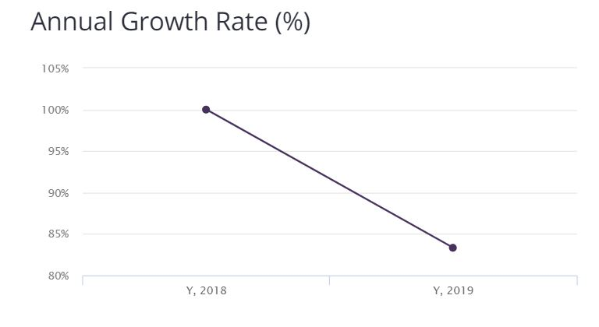
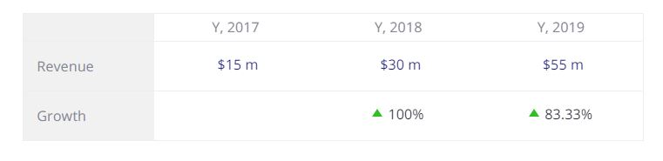
Financials
8
Data of Patreon one of our successful competitors we can assume our financials on similar lines.

Slide 10
Summary
9
Big Opportunity: Market is growing rapidly and a lot of it is untapped(Around 900 M)
Field Experience: Deep understanding/field work/experience
Technology Advantage: Integrated use of all Indian payment Wallets
Significant Market Size: 225 M Active YouTube Users.

Slide 11
THANK YOU!

